Slide 1


Stephen Sinocchi
4/10/2023

Slide 2

Outline
Executive Summary
Introduction
Methodology
Results
Conclusion

Slide 3
Executive Summary
Summary of methodologies
Two Data Collection approaches
SpaceX API using
Web Scraping from Wikipedia
Data Wrangling
Exploratory Data Analysis with SQL
Exploratory Data Analysis with Data Visualization
Interactive Visual Analytics with Folium
Machine Learning Prediction
Summary of all results
Exploratory Data Analysis result
Interactive visual analytics in screenshots
Predictive Analytics result

Slide 4
Introduction
Project background and context
Enable SpaceY to competitively bid against SpaceX for launches. Space X advertises Falcon 9 rocket launches on its website with a cost of 62 million dollars; other providers cost upward of 165 million dollars each, much of the savings is because Space X can reuse the first stage. Therefore, if we can determine if the first stage will land, we can determine the cost of a launch. This goal is to project the data science methodology and create a machine learning pipeline to predict if the first stage will land successfully.
Problems you want to find answers
What are the factors that determine a successful first stage landing or not
Condition that need to be in place for successful landing

Slide 5

Section 1

Slide 6
Methodology
Executive Summary
Data collection methodology:
Utilize SpaceX APIs utilizing Python Request Library
Perform Wikipedia Web scrapping utilizing Python Beautiful Soup Library
Perform data wrangling
One-hot encoding was applied to categorical outcome features
Perform exploratory data analysis (EDA) using visualization and SQL
Perform interactive visual analytics using Folium and Plotly Dash
Perform predictive analysis using classification models
How to build, tune, evaluate classification models

Slide 7
Data Collection
Describe how data sets were collected.
Using Get Requests we parse the SpaceX launch data API
Decode the response content using JSON and turned into pandas data frame
Use API to get additional information about the launches using the IDs given for each launch
Build a launch dictionary, create a dataframe and filter Falcon 9 launch data
Perform data wrangling to replace null values with column mean

Slide 8
Data Collection – SpaceX API
SpaceX offers API where data can be obtained
Use get requests to load data from Space X API
We Normalize, parse and filter Falcon 9 data
Build Dictionary
Create date frame
Perform data wrangling
The link to the notebook is:
https://github.com/Stoach/Data-Science-Capstone/blob/main/jupyter-labs-spacex-data-collection-api.ipynb
SpaceX API: Get Request to Load Data
Normalize, Parse and filter Data
Create Data Frame and perform data wrangling

Slide 9
Data Collection - Scraping
Use get method assign SpaceX Wikipedia HTML page content to variable.
Create Beautiful soup object
Extract all column / variables names from HTML table headers
Create dictionary by parsing HTML tables
Covert dictionary to data frame and export CSV
The link to the notebook:
https://github.com/Stoach/Data-Science-Capstone/blob/main/jupyter-labs-webscraping%20(4).ipynb
Get Method to fetch Wikipedia contents
Create Beautiful Soup Object from HTML contents
Extract columns and build dictionary
Create data frame from dictionary and export to CSV file

Slide 10
Data Wrangling
Load Space X data set
Determined percentage of missing values
Reviewed data types
Calculated number of launches at each site
Counted number of Orbits
Create landing outcome class label from outcome column
Export data frame to csv.
Link to Github notebook:
https://github.com/Stoach/Data-Science-Capstone/blob/main/labs_jupyter_spacex_Data_wrangling.ipynb
EDA Load data
Summarizations of Launch Sites and Orbits
Create outcome landing class label

Slide 11
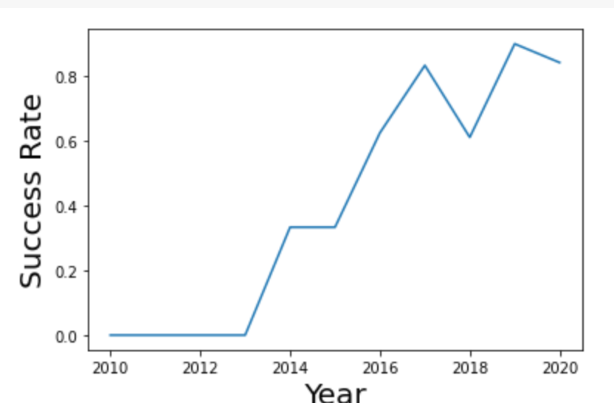
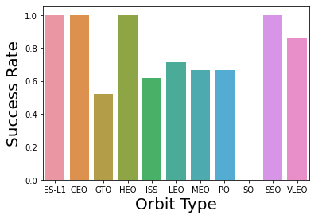
EDA with Data Visualization
Explored the data by visualizing the multiple relationship between flight number, payload, launch site, orbit, and success rate of orbit type and year.
The link to the notebook is https://github.com/Stoach/Data-Science-Capstone/blob/main/jupyter-labs-eda-dataviz.ipynb

Slide 12
EDA with SQL
From the SpaceX data set loaded into the DB2 SpaceX table
Selected distinct launch sites
Displayed five records where launch site starts with ‘CCA%’
Displayed the total payload mass carried by boosters launched by NASA (CRS)
Displayed average payload mass carried by booster version F9 v1.1
List the date when the first successful landing outcome in ground pad was achieved.
List the names of the boosters which have success in drone ship and have payload mass greater than 4000 but less than 6000
List the total number of successful and failure mission outcomes
List the names of the booster_versions which have carried the maximum payload mass. Use a subquery
List the failed landing_outcomes in drone ship, their booster versions, and launch site names for in year 2015
Rank the count of landing outcomes (such as Failure (drone ship) or Success (ground pad)) between the date 2010-06-04 and 2017-03-20, in descending order
Github Link:
https://github.com/Stoach/Data-Science-Capstone/blob/main/EDA%20with%20sql-coursera.ipynb
Add the GitHub URL of your completed EDA with SQL notebook, as an external reference and peer-review purpose

Slide 13
Build an Interactive Map with Folium
Used circle markers, color labeled clusters and lines in the Folium map
Marked Johnson Space Center and four launch sites with circles
Assigned Green or Red label to launch outcomes. Class 1 = Green, class 0 = Red.
Assigned color-labeled marker clusters to identify which launch sites have relatively high success rate or not.
Calculated the distances between a launch site to its proximities. Answered several questions:
Are launch sites in close proximity to railways?
Are launch sites in close proximity to highways?
Are launch sites in close proximity to coastline?
Do launch sites keep certain distance away from cities?
Github link:
https://github.com/Stoach/Data-Science-Capstone/blob/main/lab_jupyter_launch_site_location.ipynb

Slide 14
Build a Dashboard with Plotly Dash
Build a Plotly Dash to perform interactive visual analytics on SpaceX launch data in real-time
We added the following plots / graphs:
Pie chart depicting total success launches by site
Scatter chart illustrating correlation between payload mass and launch success
After visual analysis we answered the five questions:
Which site has the largest successful launches?
Which site has the highest launch success rate?
Which payload range(s) has the highest launch success rate?
Which payload range(s) has the lowest launch success rate?
GitHub URL:
https://github.com/Stoach/Data-Science-Capstone/blob/main/spacex_dash_app.py

Slide 15
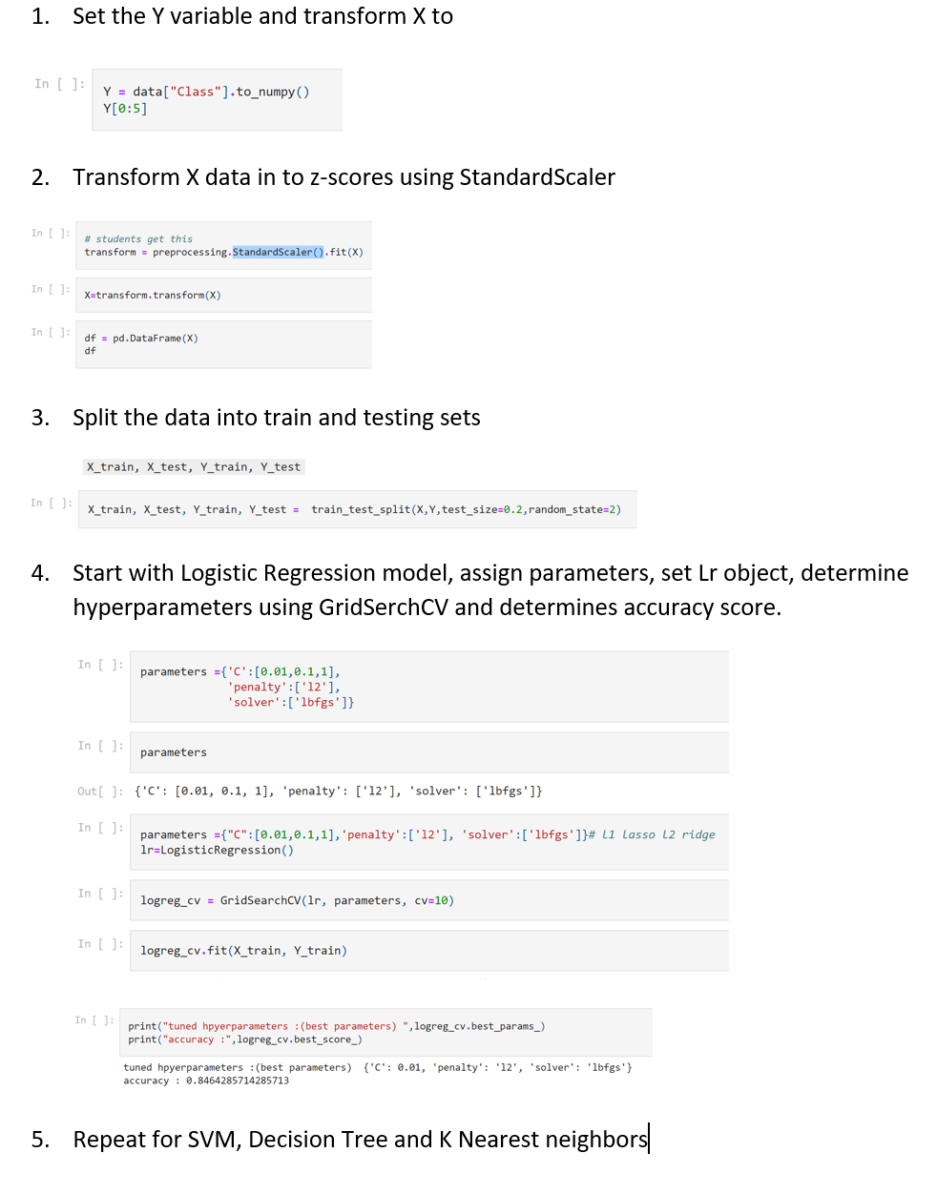
Predictive Analysis (Classification)
Loaded the data using numpy and pandas, transformed and split our data into training and testing.
We built different machine learning models and tune different hyperparameters using GridSearchCV.
We found the best performing classification model.
Notebook Link:
https://github.com/Stoach/Data-Science-Capstone/blob/main/SpaceX_Machine%20Learning%20Prediction_Part_5.ipynb

Slide 16
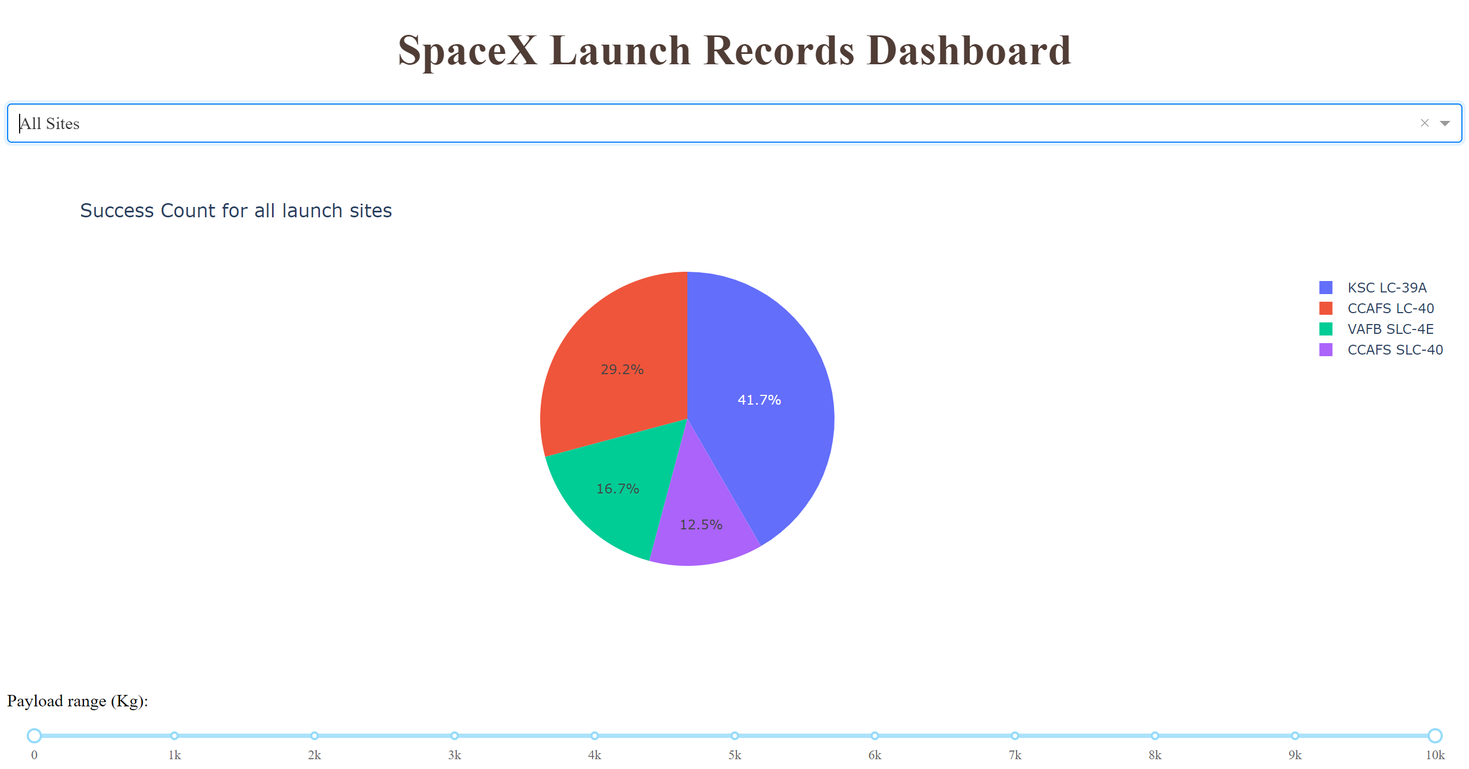
Results
Exploratory data analysis results
Success rate kept increasing from 2013 until 2020.
Predictive analysis results
Evaluated the following Algorithms:
Logistic Regression
SVM
Decision trees
K Nearest Neighbors
All algorithms scored the same with 0.8333333
Interactive analytics demo in screenshots

Slide 17

Section 2

Slide 18
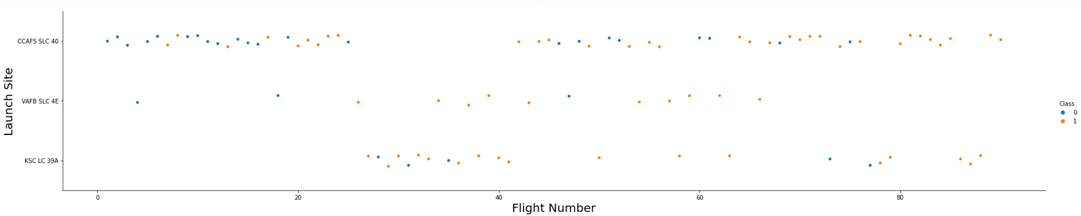
Flight Number vs. Launch Site
Show a scatter plot of Flight Number vs. Launch Site
Explanation:
CCAFS SLC 40 has highest numbers of launches. Class 0 and 1 occurrences are close
VAFB SCL 4E has least amount of launches. Class 1 occurrences are significantly greater than class 0.
Class 1 occurrences are greater for later flights are all three launch sites. They are getting better at it.

Slide 19
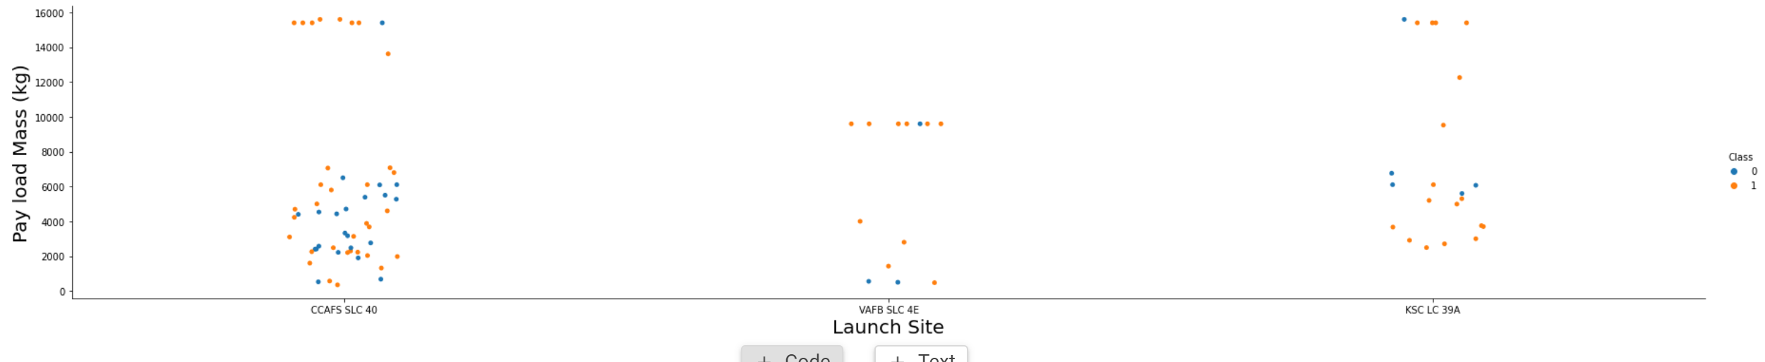
Payload vs. Launch Site
Show a scatter plot of Payload vs. Launch Site
Explanations:
Note for VAFB-SLC launch site there are no rockets launched for heavy payload mass(greater than 10000).
CCAFS SLC 40 has a lot of launches less than 8000 and higher occurrence of class 1 for heavy payload (greater than 12000).
KSC LC 30A used for light, middle and heavy payloads. Overall high occurrence of class 1.

Slide 20
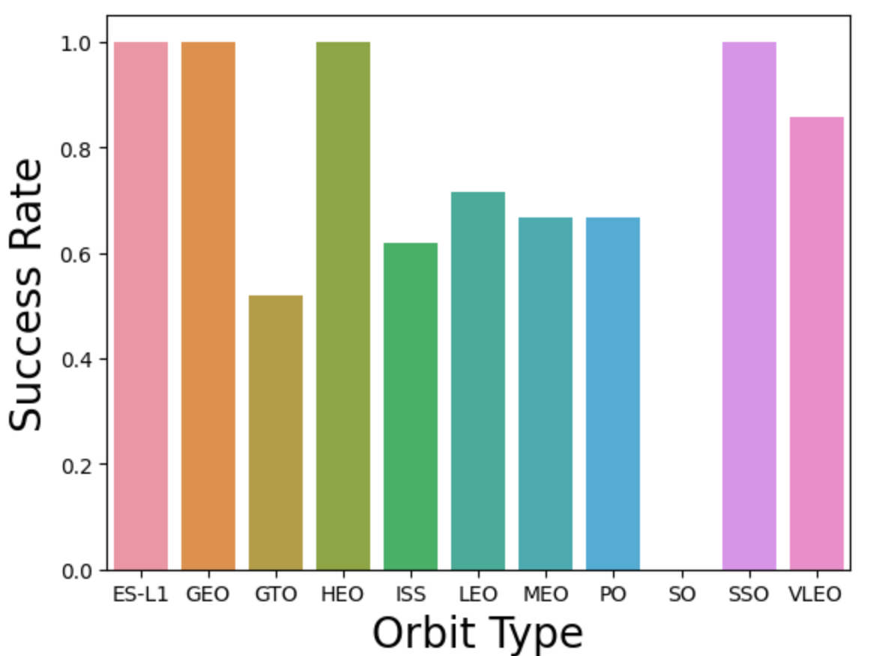
Success Rate vs. Orbit Type
The plot illustrate that ES-L1, GEO, HEO, SSO, VLEO had the most success rate.
GTO had the lowest success rate.

Slide 21
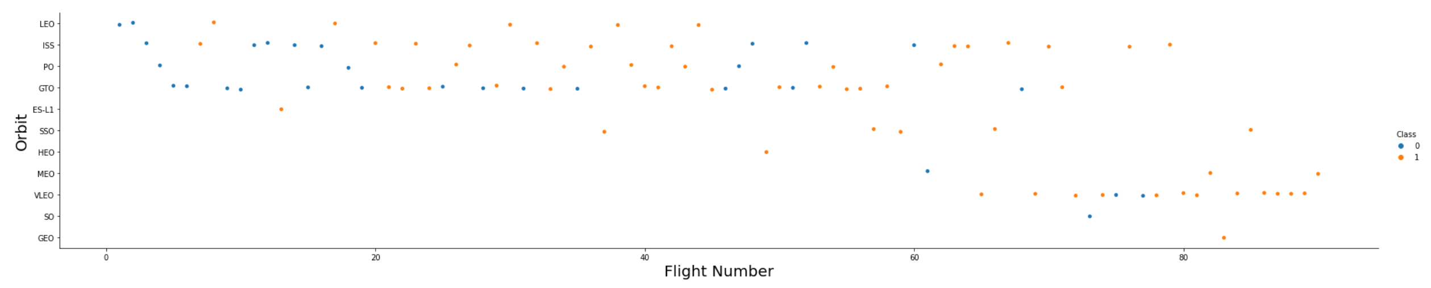
Flight Number vs. Orbit Type
You should see that in the LEO orbit the Success appears related to the number of flights; on the other hand, there seems to be no relationship between flight number when in GTO orbit.
First 80 flights primarily targeted orbits LEO, ISS, PO, GTO, ES-L1

Slide 22
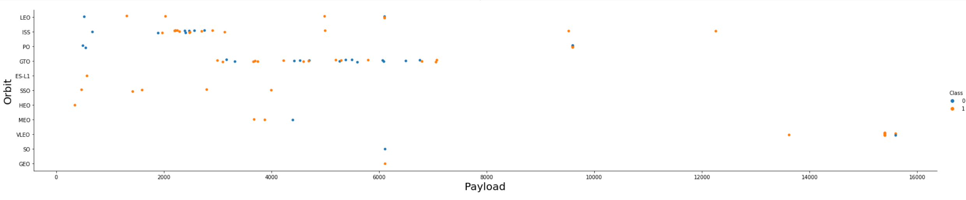
Payload vs. Orbit Type
With heavy payloads the successful landing or positive landing rate are more for LEO and ISS.
However for GTO we cannot distinguish this well as both positive landing rate and negative landing(unsuccessful mission) are both there here.
With lighter payloads the successful landing or positive landing rate are more for SSO

Slide 23
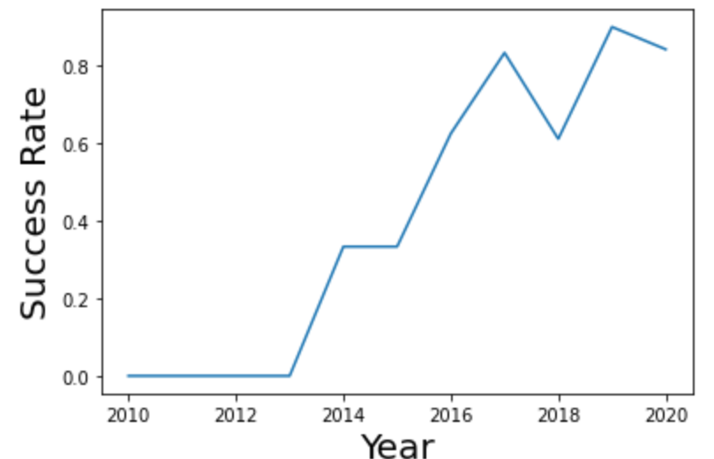
Launch Success Yearly Trend
The line plot illustrates the success rate since 2013 kept increasing till 2020
There was a two point success rate dip between 2017 and 2018

Slide 24
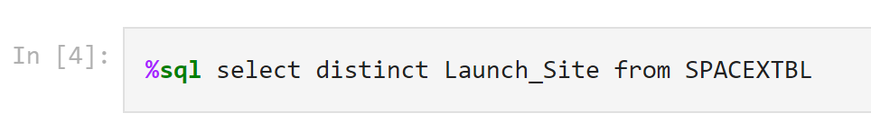
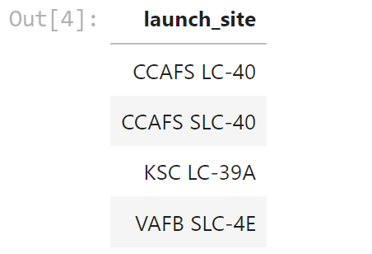
All Launch Site Names
The key distinct displays only unique launch sites in the launch_site column in the SPACEXTBL

Slide 25
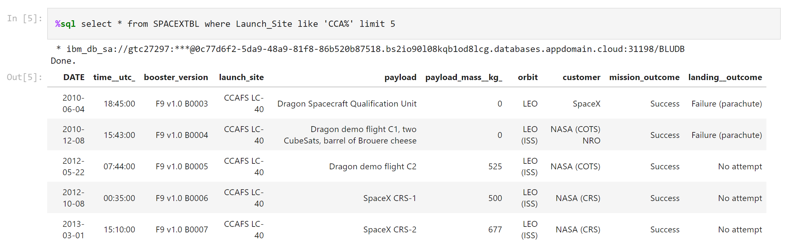
Launch Site Names Begin with 'CCA'
Display 5 records where launch sites begin with the string 'CCA‘
Note the key word like ‘CAA%’. The % acts as a wild card.

Slide 26

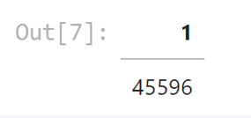
Total Payload Mass
Utilize the Sum() function on the payload_mass_kg_ column. It displays the total payload mass for all row where the customer = ‘NASA (CRS)’

Slide 27

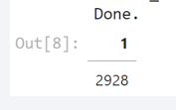
Average Payload Mass by F9 v1.1
Utilize the avg() function to calculate the payload mass for booster version F9 v1.1

Slide 28

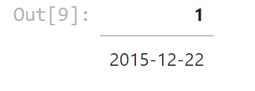
First Successful Ground Landing Date
By using the MIN() function on the data column, we can fetch the earliest or minimum date of a successful landing outcome on a ground. Note the criteria of the where clause.

Slide 29

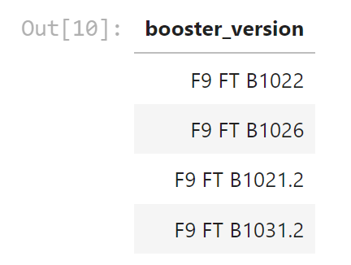
Successful Drone Ship Landing with Payload between 4000 and 6000
We select the booster_version column from the SPACEXTBL with two where clause criteria. We use the AND clause because both condition must be true.

Slide 30

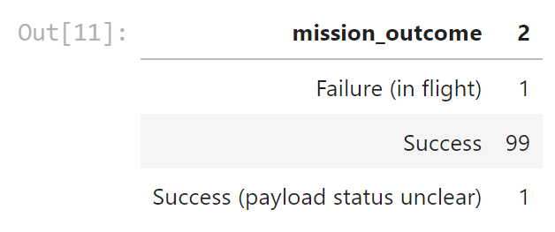
Total Number of Successful and Failure Mission Outcomes
Use the count() function and group by mission outcome to count the number of each mission outcome

Slide 31
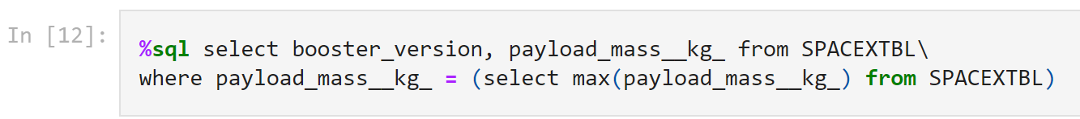
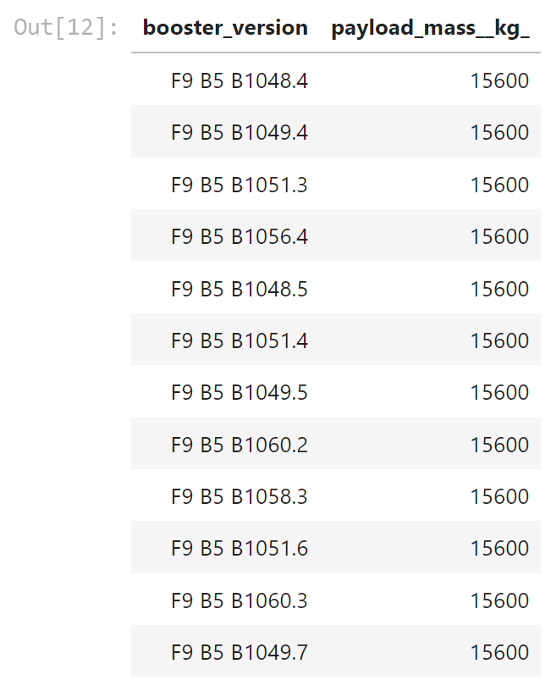
Boosters Carried Maximum Payload
By using a sub-query to fetch the maximum payload we can query the booster versions and payload from the SPACEXTBL where the payload equals the maximum payload.

Slide 32

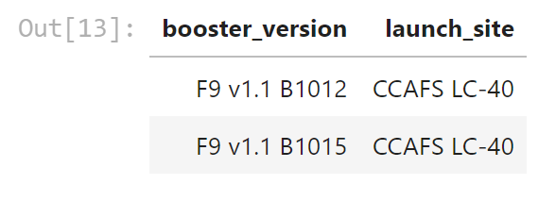
2015 Launch Records
Select the booster version, launch site and landing outcome where the landing out equals = ‘Failure (Drone Ship)’ and the date between January 1st and December 31 2005.

Slide 33
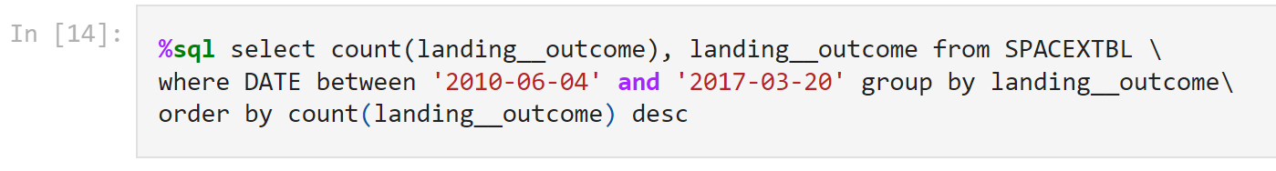
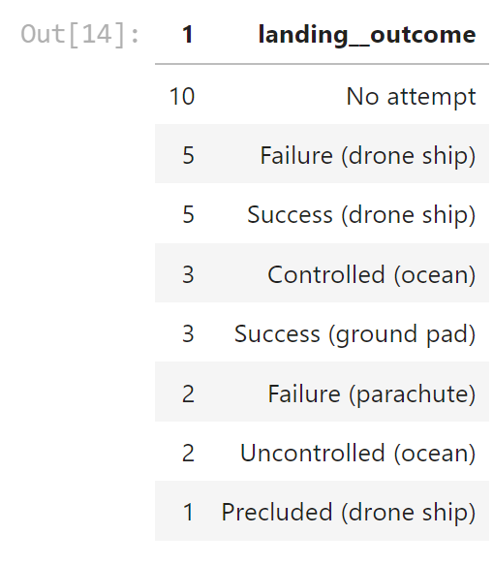
Rank Landing Outcomes Between 2010-06-04 and 2017-03-20
By grouping the landing outcomes and applying the count function, the query returns the total number of landing outcomes in the table. Ordering by the count in descending order we can rank from highest to lowest landing outcome counts.
The between clause in the where criteria is used filter between the desired dates.

Slide 34

Section 3

Slide 35
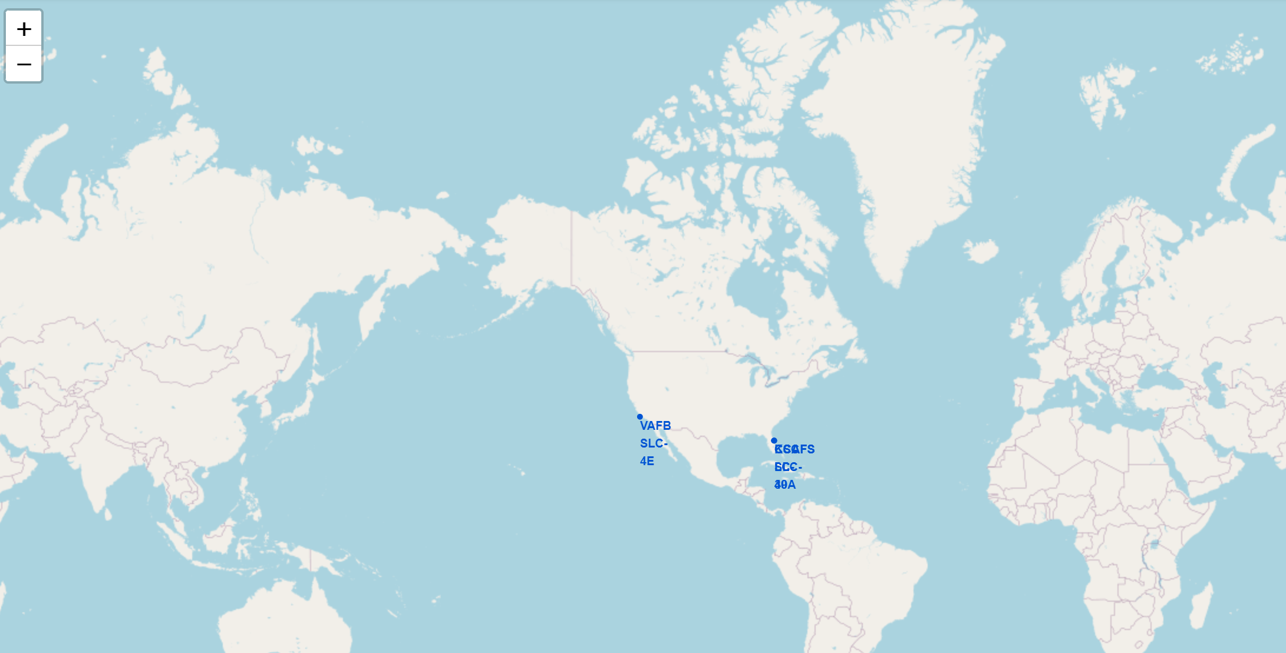
All SpaceX Launch Site Global Map Markers
Note three SpaceX launch sites in the United States
One on the west coast and two on the east coast

Slide 36
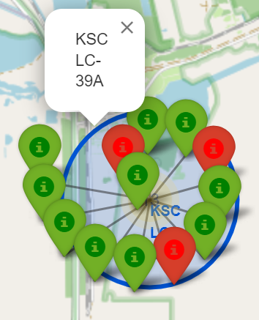
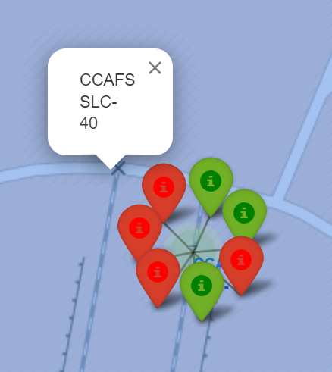
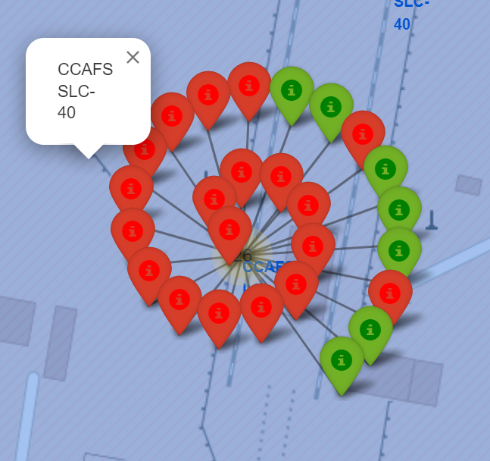
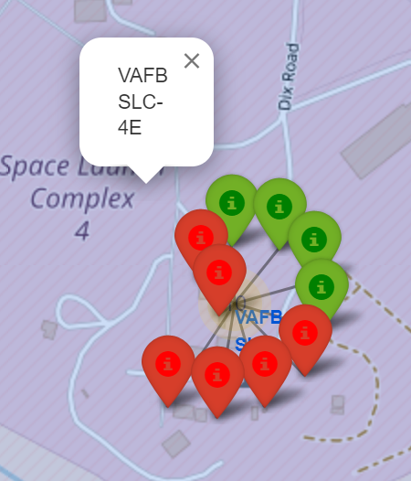
Markers showing launch sites with color labels
Note that a launch only happens in one of the four launch sites, which means many launch records will have the exact same coordinate. Marker clusters can be a good way to simplify a map containing many markers having the same coordinate.
Three Florida Launch Sites
One California Launch Sites
Green Markers illustrate Successful Launch
Red Markers illustrate Failed Launch

Slide 37
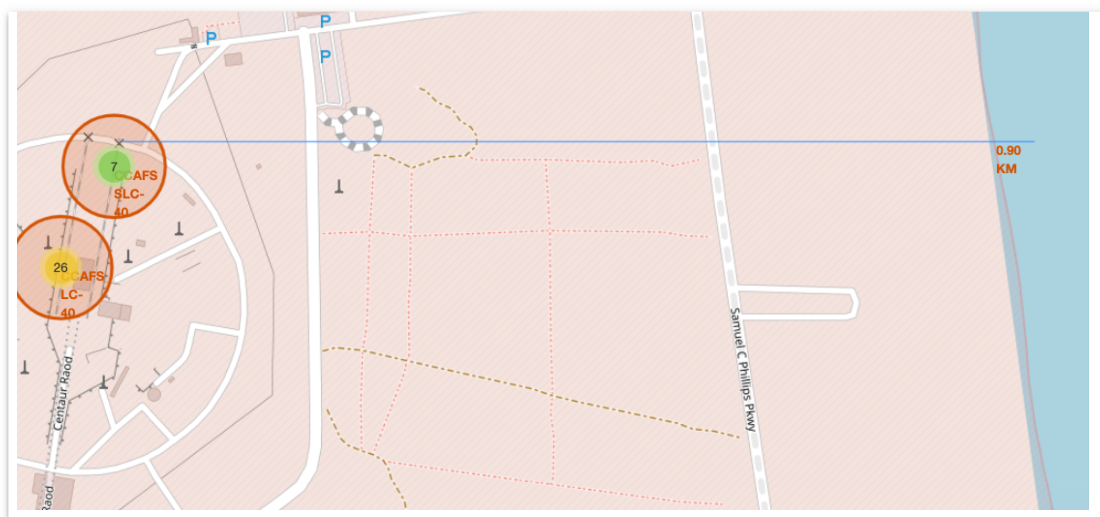
Launch Site Distance to the Coastline
To illustrate the distance from launch site CCAFS SLC-40 to the coastline to draw a polyline between the two. We can see the distance is 0.90 KM.

Slide 38

Section 4

Slide 39
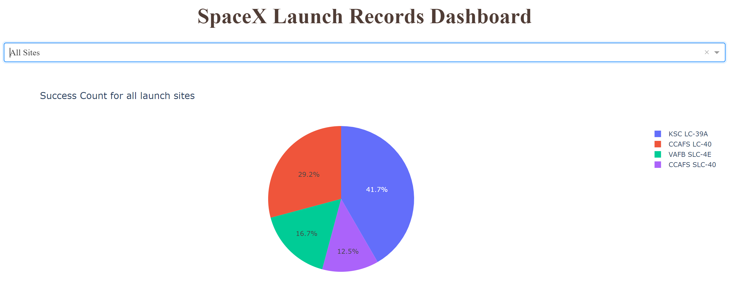
Pie Chart of SpaceX Launch Site Success Count Percentages
All sites are selected from drop down list box
KSC LC-39A has the highest success percentage

Slide 40
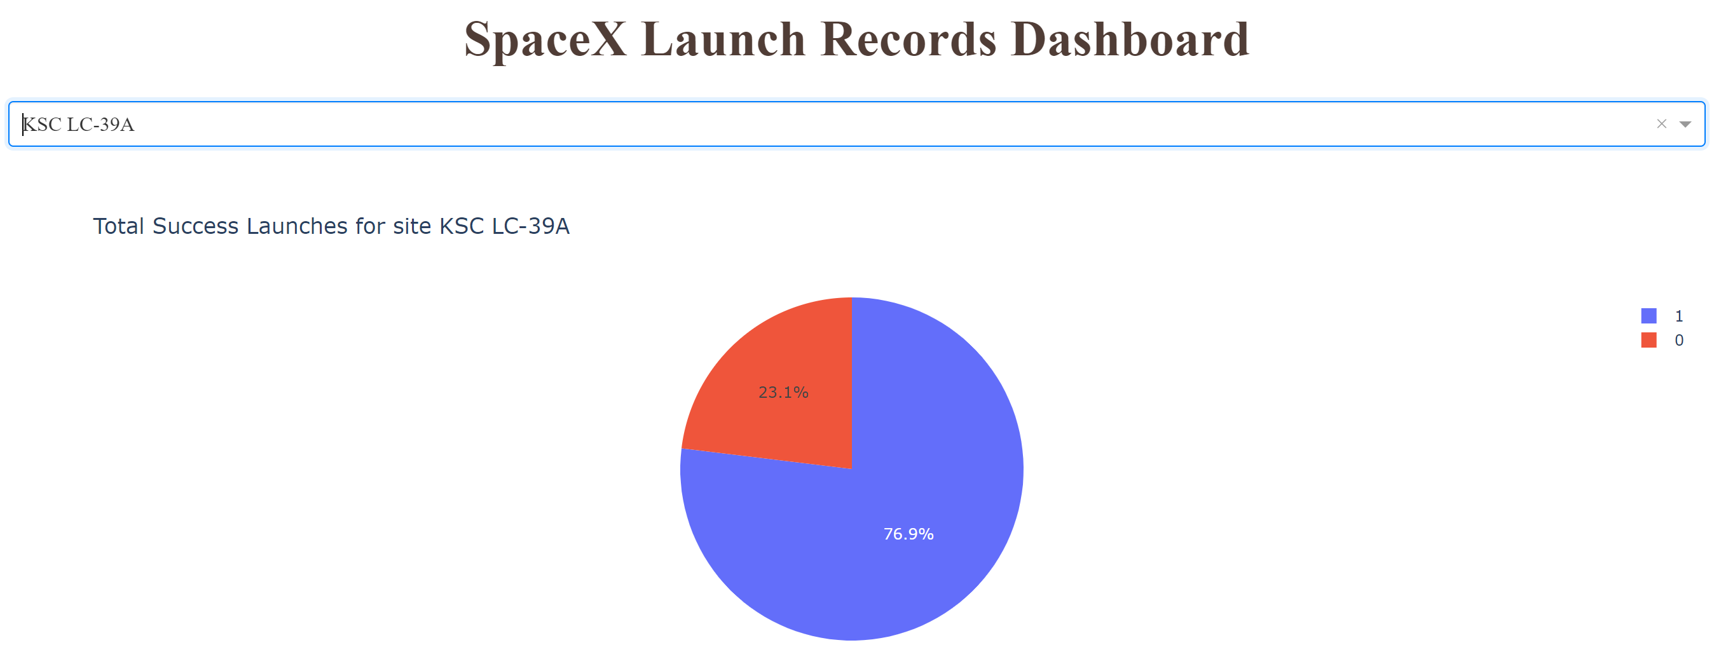
Pie Chart of Launch Site with Highest Success Rate
KSC LC-39A has a success rate of 79.9% and failure rate of 23.1%.

Slide 41
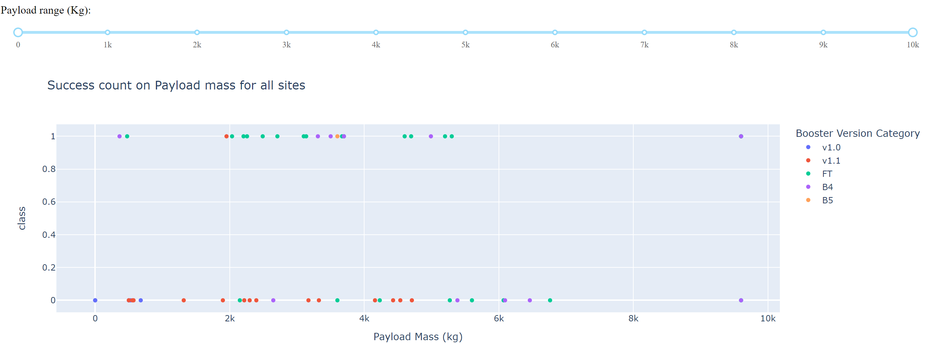
Scatter Plot of Payload vs. Launch Outcome for All Sites
Note payload sider scale
We can see a higher success rate for lighter payloads compared to heaver payloads

Slide 42

Section 5

Slide 43
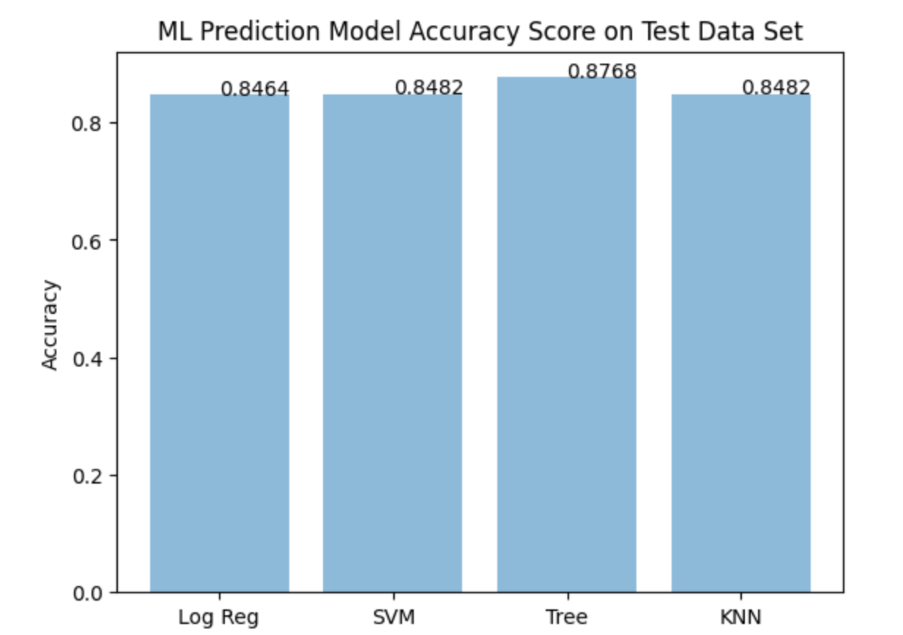
Classification Accuracy
From the bar char below, the Decision Tree Model has the highest accuracy at 0.87.

Slide 44
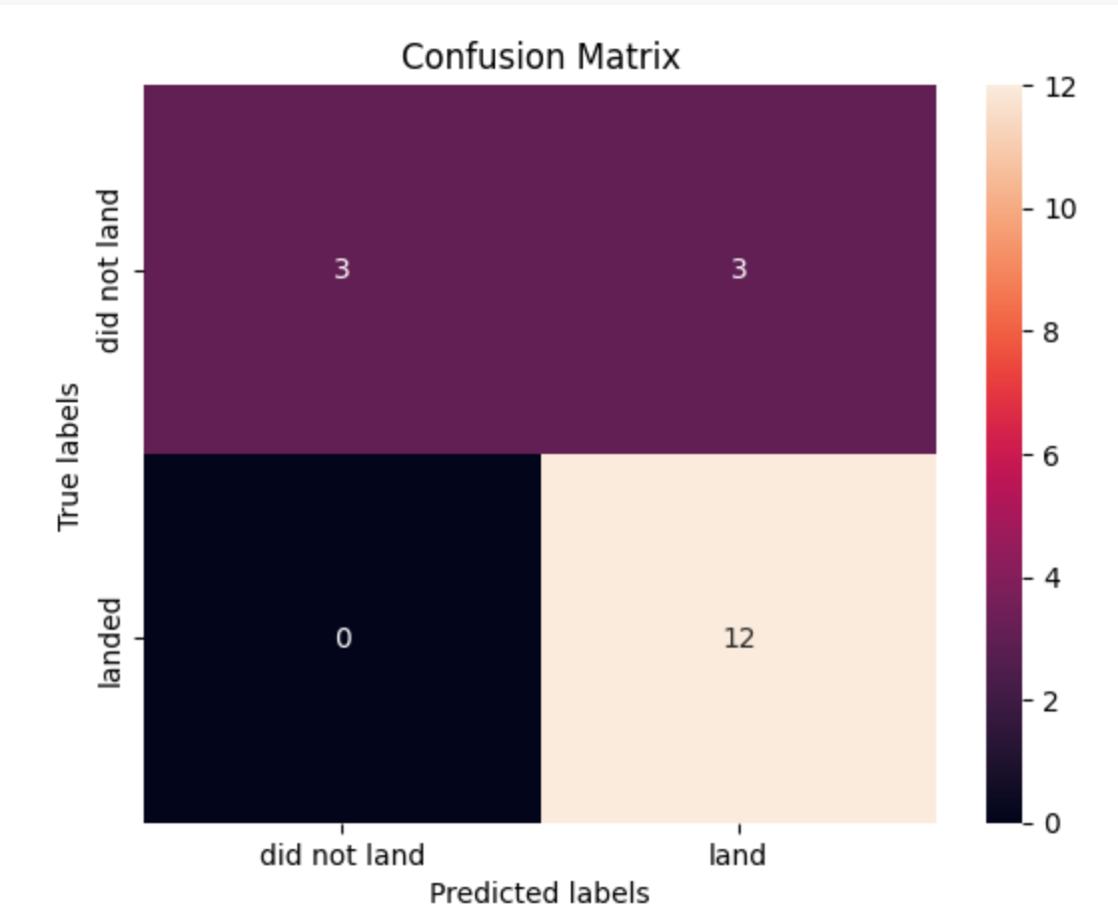
Confusion Matrix with Explanation
A confusion matrix summarizing the performance of the Decision Tree algorithm.
The Matrix illustrates:
3 True Positives (Upper Left Quadrant)
3 False Positive (Upper Right Quadrant)
0 False Negative (Lower Left Quadrant)
12 True Negatives (Lower Right Quadrant)
The concern is the 3 False Positives. Unsuccessful lands predicted a successful.

Slide 45
Conclusions
We can conclude that:
CCAFS SLC-40 has highest numbers of launches
Heavier Payloads (greater than 8000) have a high success rate at all Launch Sites
Launch success rate increased between 2013 and 2020.
Orbits ES-L1, GEO, HEO, SSO, VLEO had the most success rate
KSC LC-39A had the most successful launches of any sites.
CCAFS SLC-40 has the most unsuccessful launches of any sites.
The Decision tree classifier is the best machine learning algorithm for this task.

Slide 46


